Slide 1
New Git Concepts
Name: Abhishek Kumar
Roll: 21EC30001
Koss interview task

Slide 2

Content Layout
What is Git
Getting started(creating a repo)
Making changes
Viewing project history( logs/diffs)
branches/switch/merging
Git stash
Git bisect
Git rebase
Git Cherry-pick

Slide 3

What is Git
Git, is a version control system. It is free, open source and is used by most of the open source software developers to
Create
Managing/tracking status of the projects
Store the code at the local git servers
Basically it is a all in one Swiss knife for programmers

Slide 4
Getting started
$git init
$git add .
Initialized empty Git repository in .git/
take a snapshot of the contents of all files under the current directory
$git commit
permanently store the contents of the index in the repository

Slide 5
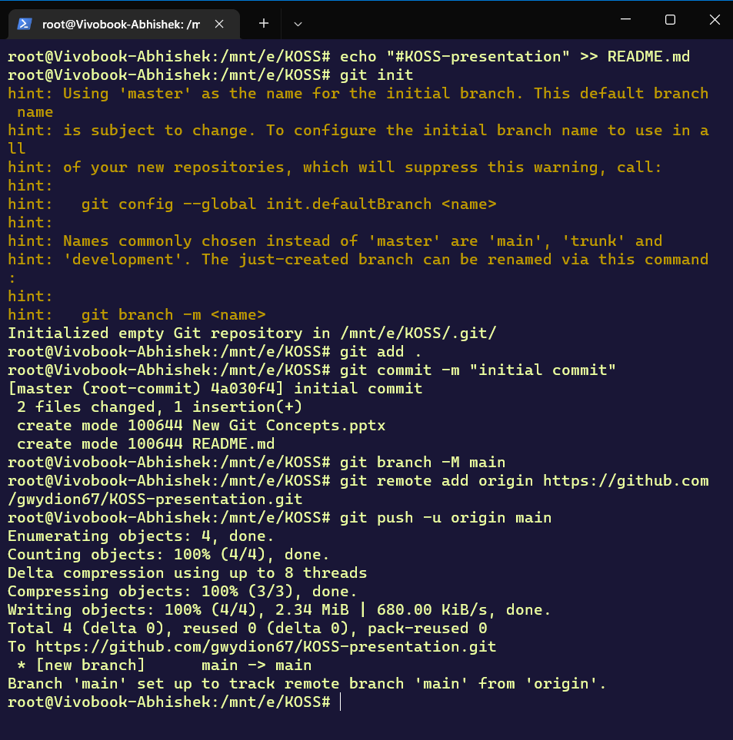
This is the preview of the said commands .
I have used them to create a repo and push them to GitHub

Slide 6
Making changes
After modifying some files to add specific files(say file1, file2) to the index $git add file1 file2
Using git status or git diff –cached we can see the changes that will occur after the next commit
git diff will show changes that are made but not yet added to the index.
git status gives a brief summary of the situation of the changes
git commit –a
Can be used to commit without using git add beforehand

Slide 7
The Project History
📋 Logging
➔git log
➔git log --oneline # more succinct output
➔git log --graph #with a visual graph of branches
TO VEIW THE “undo” history
➔git reflog
View your current state + any merge conflicts
➔git status
See the differences in your staged (or unstaged) changes
➔git diff--staged # for staged changes
➔git diff #for unstaged changes
➔git diff branch1..branch2 #see differences between two branches
Uncommit the previous changes(this will uncommit and leave the files in the working directory}
➔git reset <commit-sha>

Slide 8
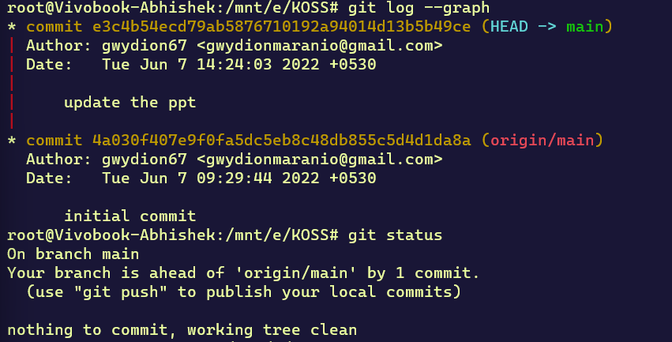
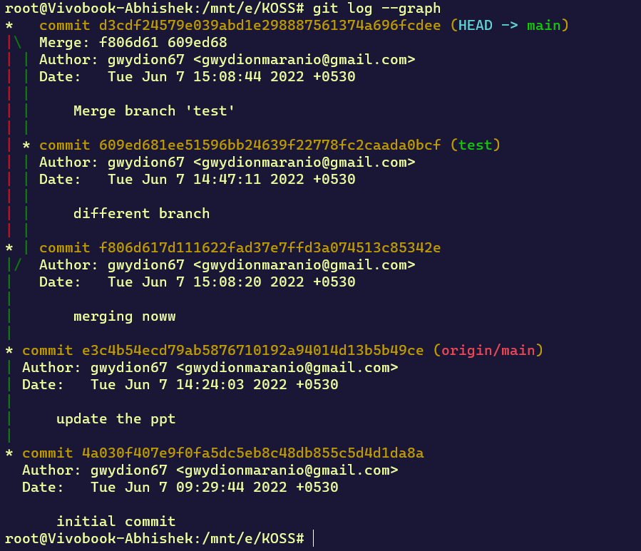
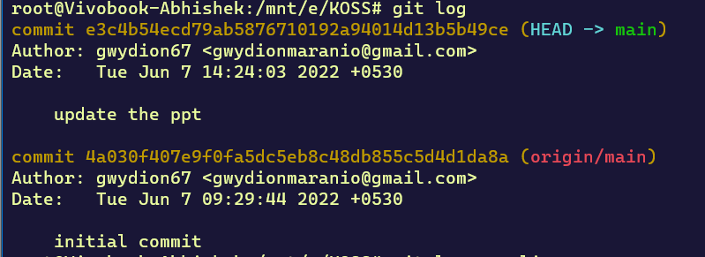
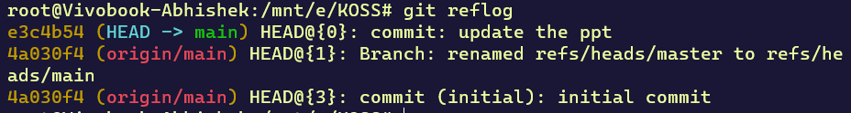
The project history

Slide 9
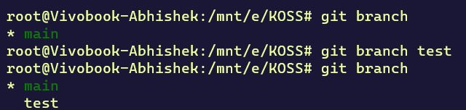
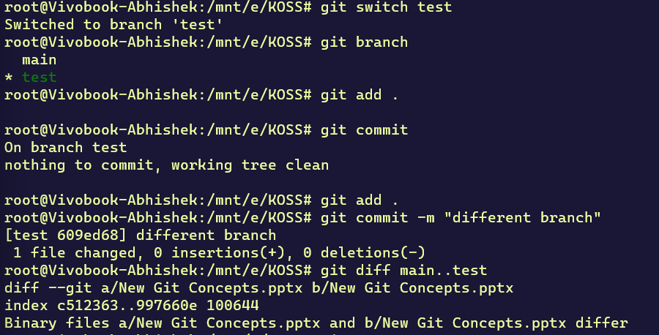
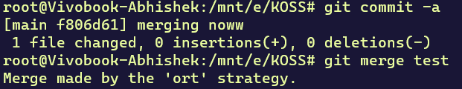
Branches-switching/merging
Creating a branch:
Git branch is used to create a new branch git switch/git checkout is used to switch between branches
Git merge is used to merge the branch with any other branch
In case of a merge conflict use git diff to check the conflict and merge after resolving the conflict
Switching branch and changing in new branch:
Merging the two branches :

Slide 10
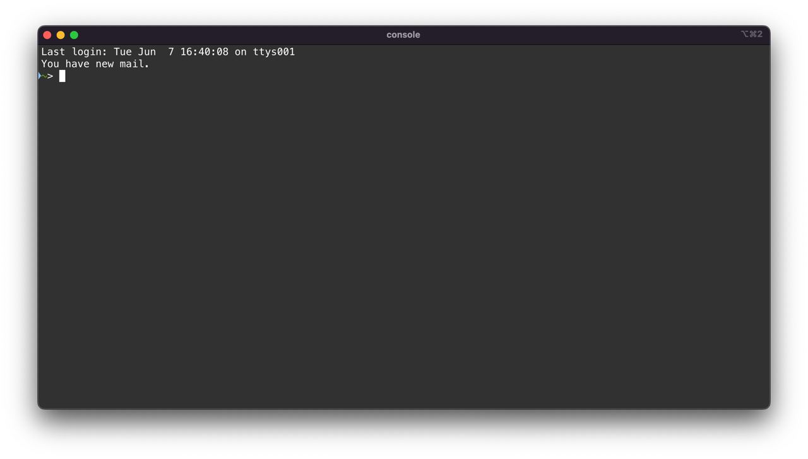
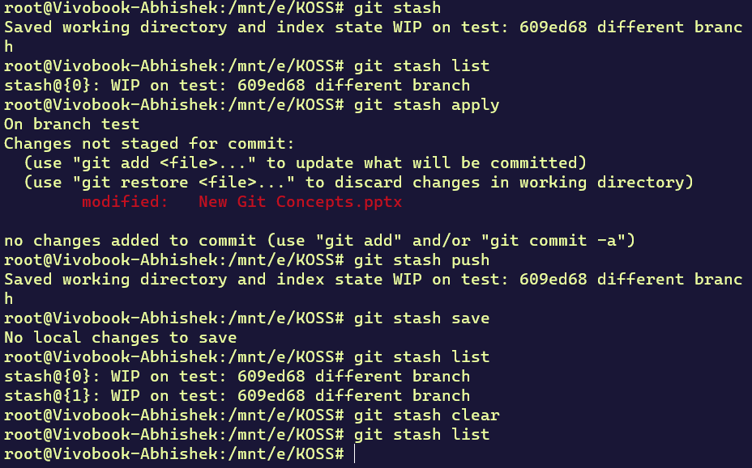
Git stash
It allows one to save a copy of the code without making a commit.
$git stash list #Enable one to see the list of the stashes
$git stash apply #To reapply the stashed code
$git stash push #Creates a new stash and rolls back the state of all modified files
$git stash pop # Takes the files in a stash, places them back into the development workspace and deletes the stash from history
$git stash clear #Removes all entries in the git stash history
$git stash save "message to go along with changes"
$git stash –u #stash untracked files as well

Slide 11
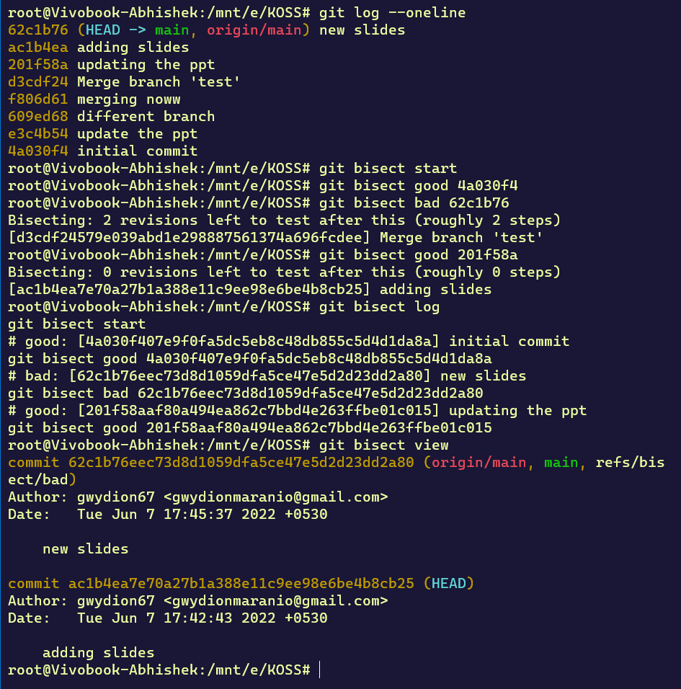
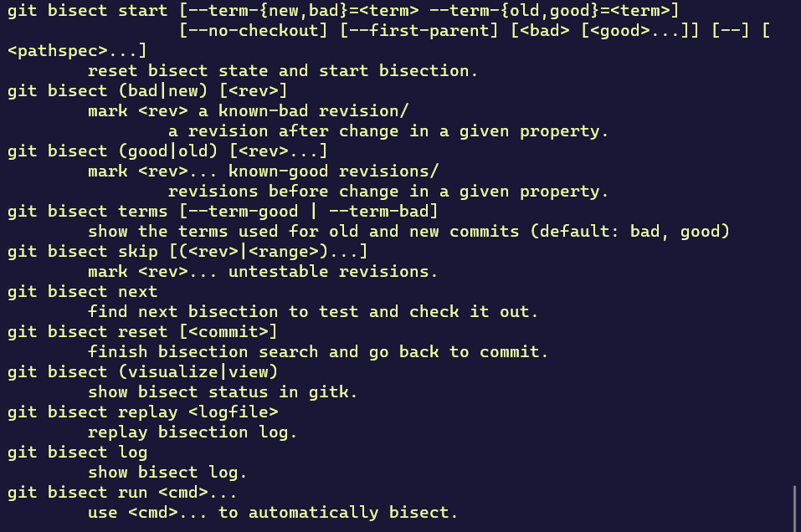
Git bisect
The git bisect command implements a binary search algorithm to track which commit caused the bug

Slide 12
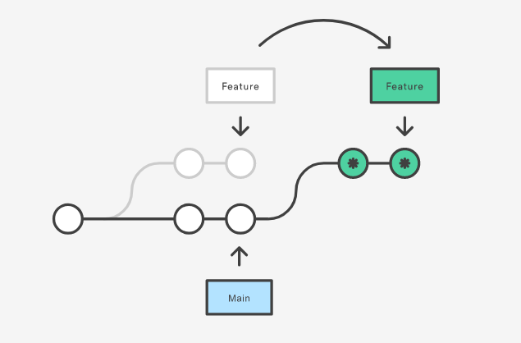
Git rebase
Assume the following history exists and the current branch is
"topic":
A---B---C topic
/
D---E---F---G main
From this point, the result of either of the following commands:
git rebase main
git rebase main topic
would be:
A'--B'--C' topic
/
D---E---F---G main
Rebasing is the process of moving or combining a sequence of commits to a new base commit. rebasing is changing the base of your branch from one commit to another making it appear as if you'd created your branch from a different commit.

Slide 13
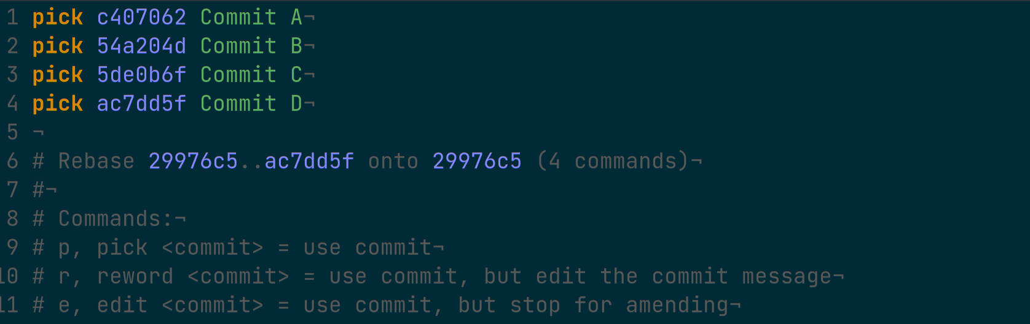
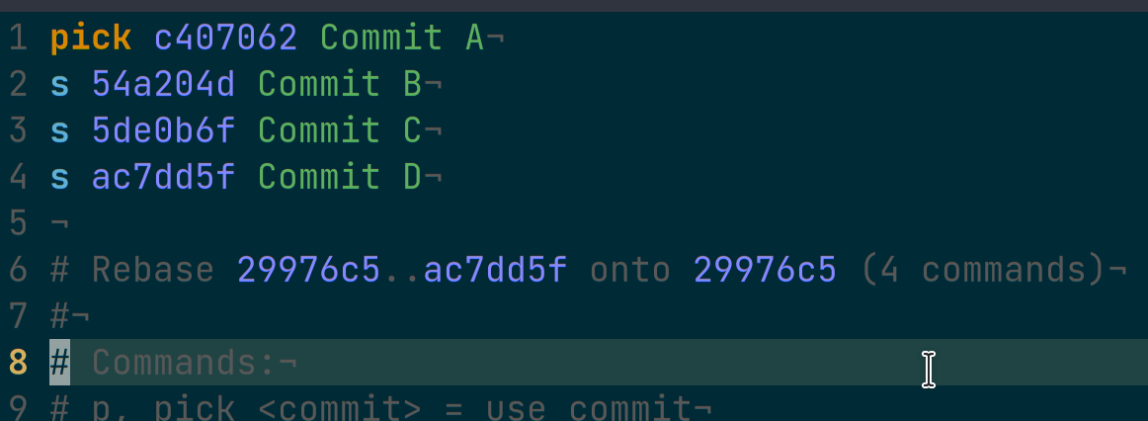
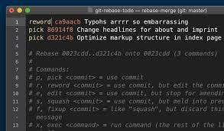
Git rebase can also be used to squash two or more commits into one as well to rename a commit
This will squash the commits B,C,D into a single commit i.e. A
To change the commit message we use reword

Slide 14
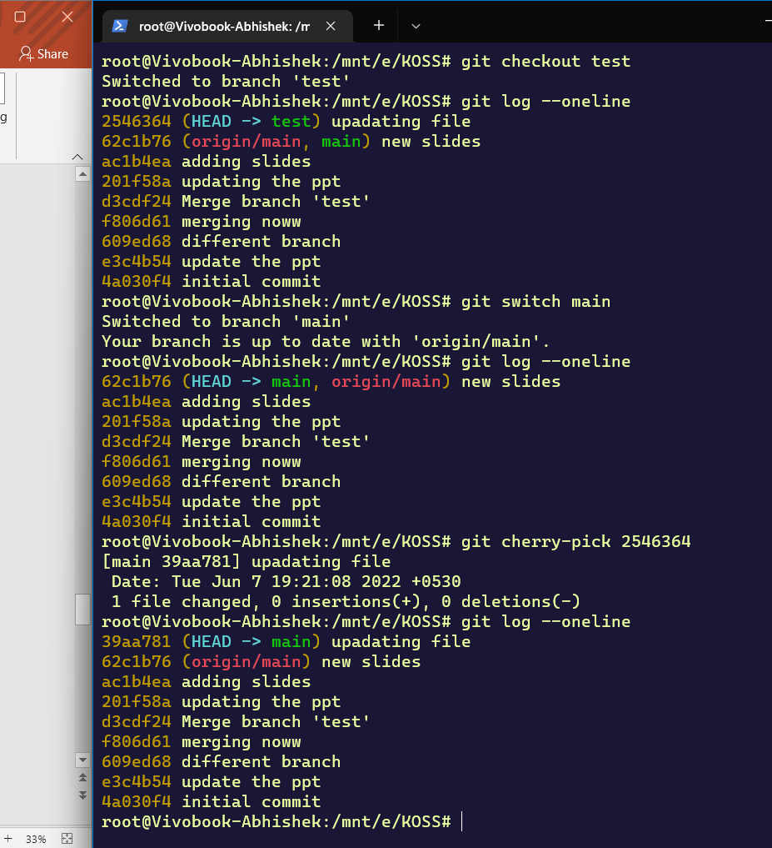
Git cherry-pick
Git cherry-pick is used to merge specific commits from one branch to other
git cherry-pick <commit-sha>
This merges the particular commit to the current branch
**cherry-pick is rarely used as it can easily arise merge conflicts

Slide 15
Arigatogozaimashita!!
For further contacts:
ʘ Telegram--@maranio67
ʘ GitHub--gwydion67

Slide 16
Sources:
➔dev.to
➔toptal
➔Atlassian
➔git

